Slide 1
Operating Systems
Dr Adnan Ghafoor

Slide 2
Lecture#1
Introduction to Operating System

Slide 3
What is an Operating System?
First See Computer system organization

Slide 4
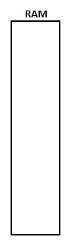
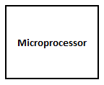
Computer Organization

Slide 5
Computer Organization
Address Bus
Data Bus
Control BUS

Slide 6
Computer Organization
HDD
Address Bus
Data Bus
Control BUS
USB
I/O

Slide 7
Computer Organization
Address Bus
HDD
Data Bus
Control BUS
USB
Other
Timer

Slide 8

Computer Organization
Address Bus
HDD
Data Bus
Control BUS
USB
Other
Timer

Slide 9
Boot Process
First address loads to the address bus is 0xFFFF0, called reset address
ROM is mapped at 0xFFFF0
First program executes from ROM, called bootstrap
  Loads the first sector of the bootable device to 0x07C00, called boot address
Transfer Control to 0x07C00
  Whatever written in boot sector executes

Slide 10
Need of Operating System
Whatever is in boot sector will be executed.
  Boot sector is of 512B only
  Loading first sector to RAM is the responsibility of ROM.
There is a need of a utility that let us choose a program which is to be executed.
  Provides user interface
  Provides programmer interface
    For reading input
    For displaying characters on screen
    Access files

Slide 11
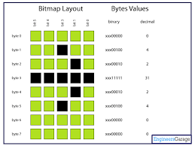
Operating System
It is a resource organizer that creates an environment where other software can run.
Without Operating System
  A program has to
    Read key from keyboard buffer itself
    Write character patterns directly to video memory
    Must implement file system
    Write driver of every hardware it intend to use
    In nutshell: It will do everything an OS does.

Slide 12
Lecture#2

Slide 13
Terminologies
Multiprogramming
Multitasking
Multiprocessing
Multithreading

Slide 14

Multiprogramming
Multiple programs are loaded into memory
One program executes at a time
On I/O call control is taken from the running process and given to another.
Control is taken only if a program makes I/O call or terminates

Slide 15
Multitasking
Multiple programs are loaded into memory
One program executes at a time
On I/O call control is taken from the running program and given to another.
Time slice is allocated to each program
When time slice expires, control is taken from running program and transfer to another

Slide 16
Multiprocessing
Multiple programs are loaded into memory
Multiple programs execute at a time depending upon the number of CPUs available
If the number of programs is equal to the number of CPUs then there is True parallel processing
If the number of program exceeds number of available CPUs then multitasking takes place
CPU0
CPU1
CPU2
CPU3

Slide 17
Protection violations
Memory Protection violation
I/O Protection violation
CPU Protection violation

Slide 18
Memory Protection
There are multiple programs residing in the memory
One program changes the variables of other programs.
There should be a check on it.
xxxxxxxx

Slide 19
I/O Protection
One program may access I/O devices directly bypassing all security checks.
Accesses files that belongs to another user.
Using In/Out instructions

Slide 20
CPU protection
A control may stuck in an infinite loop.
While(1)
{
}

Slide 21
Dual-Mode of Operation
Kernel Mode
  In kernel mode, CPU executes all instructions.
  Even if the harmful operation is performed
  Kernel of OS executes in kernel-mode
User Mode
  In user mode, CPU executes only non-privileged instructions. Instructions which are safe to execute.
  User processes execute in user-mode.
  ALU instructions
  JMP branch within the limit

Slide 22
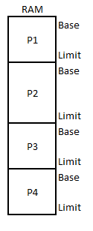
Memory Protection (Solution)
Every program residing in memory is assigned a limit.
If a program exceeds its limit in user mode, it is trapped.
A program can’t change its limit in user-mode.

Slide 23
I/O Protection Solution
I/O instructions can’t be issued in user-mode.
Issuing I/O instructions in user-mode generate a trap.

Slide 24
CPU Protection (Solution)
Timer, a controller, generates interrupts at fixed intervals.
Interrupts transfer control to the kernel in kernel mode.

Slide 25
Lecture#3

Slide 26
Interrupts
Hardware Interrupts
  Generated by I/O devices
Software Interrupts
  Generated programmatically
  E.g. int 0x21
Exceptions
  Trap ➔ Control is return to the next instruction which caused exception
  Fault ➔ Control is return to the same instruction which caused exception
  Double Fault ➔ Exception within exception

Slide 27
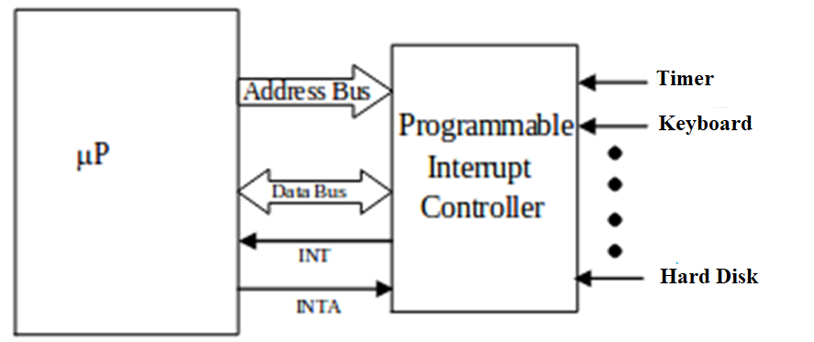
How hardware Interrupts are generated?

Slide 28
How software Interrupts are generated?
DX ← Data for kernel
Ah ← Service#
int #num

Slide 29
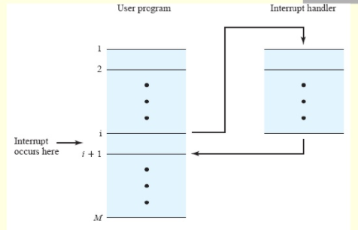
How Interrupts are handled

Slide 30
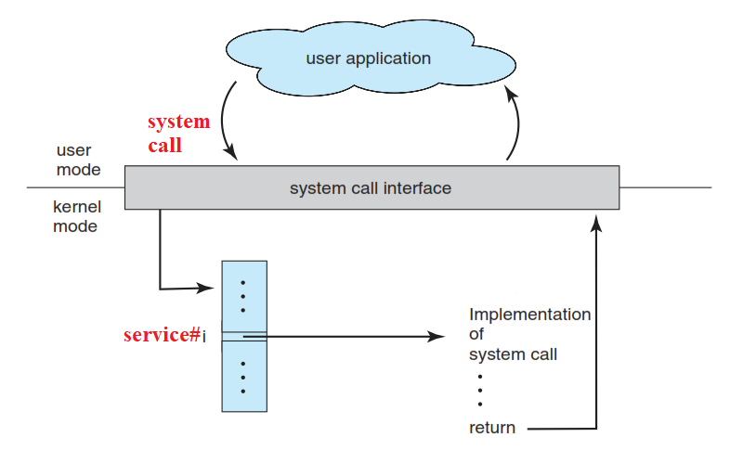
System Call
DX ← Data for kernel
Ah ← Service#
int #system call num

Slide 31
Application Programmer Interface
Print (char* str)
{
DX ← str
Ah ← 0x9
int 0x21
return
}

Slide 32
Why API is preferred over System Call
System calls are complex to invoke

Slide 33
Lecture#4

Slide 34


Program
int a=5;
int b=10;
main()
{
int c;
c = a + b;
cout<<c;
return 0;
}
Program
Process

Slide 35
How to boost performance
You have an array of 1000 elements and you need to search a number from it.
How would you speedup searching?
How would you exploit multiprocessing?
Solution
  By creating process
    int fork ()

Slide 36
Lecture#5

Slide 37

Creating Child Process
int main()
{
  printf(“Hello \n”);
  fork();
  printf(“World \n”);
}
Parent
P1
P2
Child

Slide 38
Pid_t fork()
Creates new process
Fork() is called once and returned twice
Returns 0 to the child process
Returns ID of child process to parent process (>1)

Slide 39
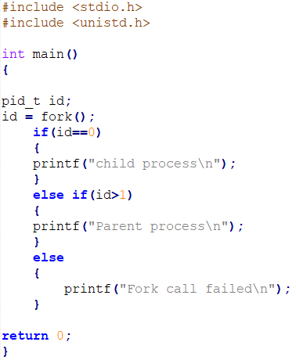

Slide 40
Lecture#6

Slide 41
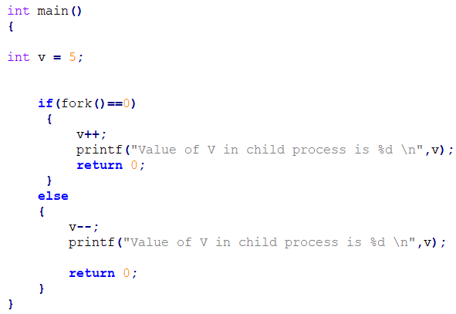
Output of a program

Slide 42
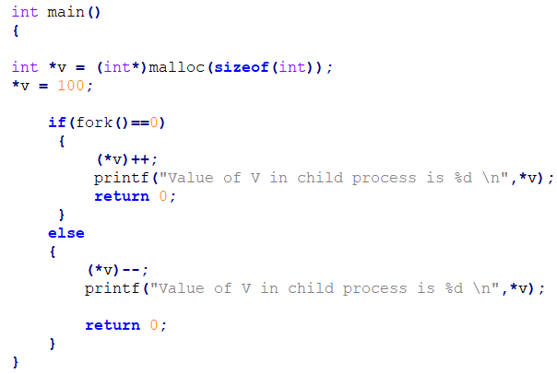
Output

Slide 43
5-state process diagram
NEW
Terminate
admitted
Ready
RUN
CPU assign
Exit
Time slice over
I/O Complete
I/O call
Wait

Slide 44
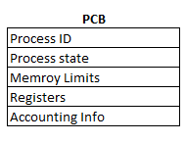
Process Control Block

Slide 45
Lecture#7

Slide 46
Short-term Scheduler (CPU Scheduler)
NEW
Terminate
admitted
Short-term
scheduler
Ready
CPU assign
RUN
Exit
Time slice over
I/O Complete
I/O call
Wait

Slide 47
Long-term Scheduler (Job Scheduler)
NEW
Terminate
admitted
Ready
RUN
Long-term Scheduler
CPU assign
Exit
Time slice over
I/O Complete
I/O call
Wait

Slide 48
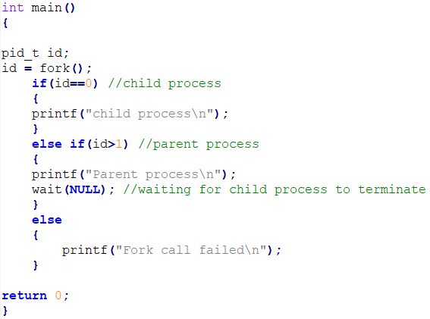
Parent process waits for child process to terminate

Slide 49
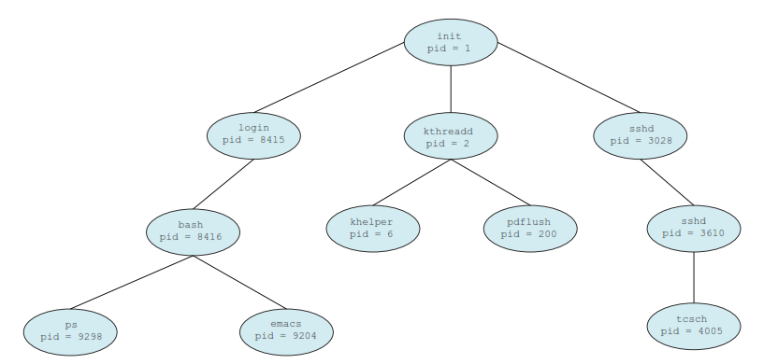
Orphan & Zombie Process
An orphan is child process that is reclaimed by init when the original parent process terminates before the child.
A Zombie is created when a parent process does not use the wait system call after a child dies to read its exit status,

Slide 50
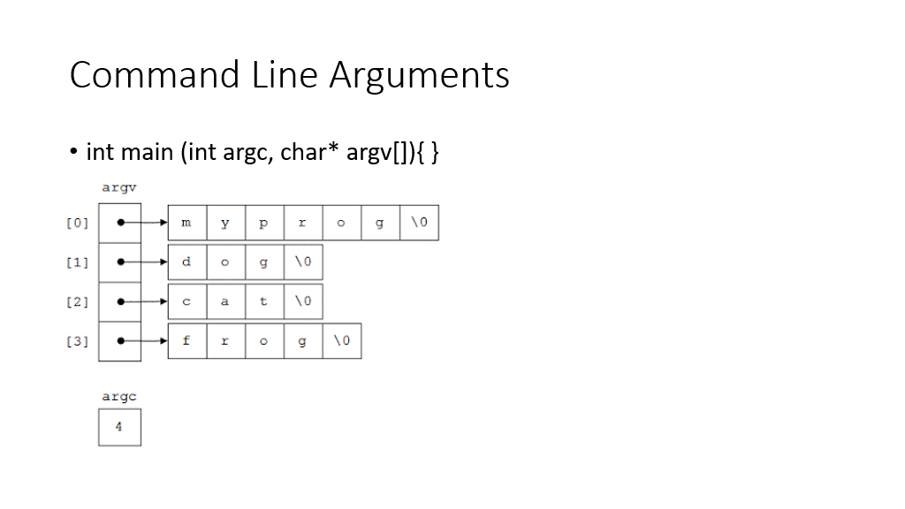

Slide 51
Lecture#8

Slide 52
Exec
The exec() family of functions replaces the current process image with a new process image. ​
int execl(const char *path, const char *arg, ...);​
int execlp(const char *file, const char *arg, ...);​
int execv(const char *path, char *const argv[]);​
int execvp(const char *file, char *const argv[]);​

Slide 53
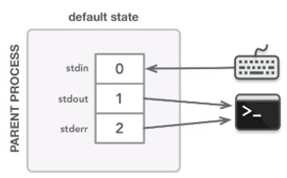
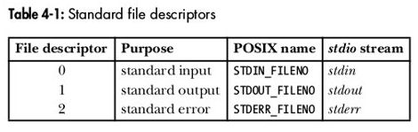
Standard Descriptors in every process
Every process has a descriptor table & its PCB contains a pointer to that table.​
First 3 descriptors in descriptor table have default meanings that can be changed. ​

Slide 54
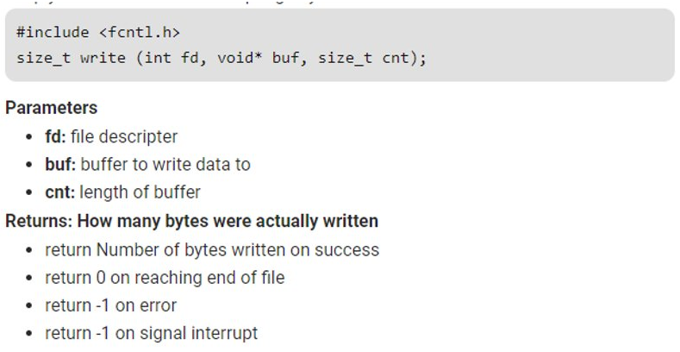
Writing to Descriptor

Slide 55
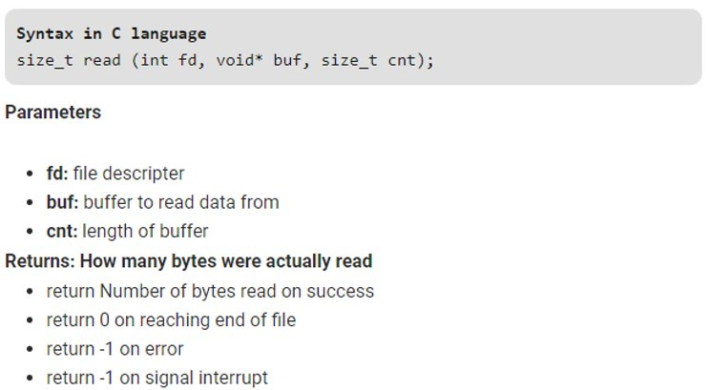
Reading from Descriptor

Slide 56
Inter-Process Communication
Pipes​
  Anonymous Pipes (Used for IPC between processes having same ancestor)​
Named Pipes (FIFOs)​
Shared Memory​
Sockets​

Slide 57
Lecture#9

Slide 58
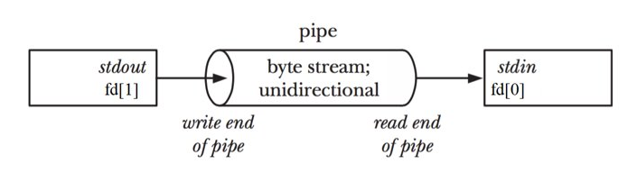
Anonymous Pipes
int pipe (int fd[2)​
Creates a pipes and places the descriptors of write & read ends to fd[1] and fd[0] respectively. ​
On success zero is returned. -1 is returned on error.​

Slide 59
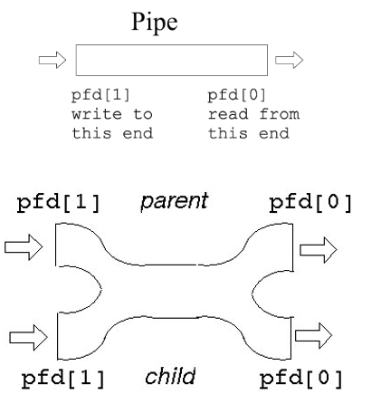
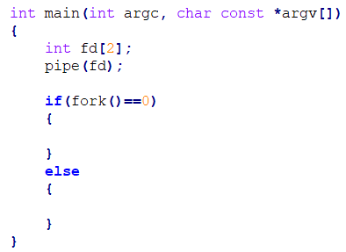
After Fork()

Slide 60
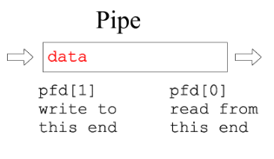
Synchronization mechanism in Pipe​
Read() is blocked if pipe is empty​
Write() is blocked if pipe is full. (Pipe has limited capacity e.g. 4KB)​
​
Read() on a pipe whose write end has closed returns 0 (EOF). ​
Write() on a pipe whose read end has closed generates a signal named SIGPIPE​

Slide 61
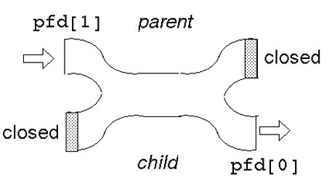
Closing un-used ends of pipe
When a process is terminated, all of its descriptors are closed.​
Writing to pipe whose all read ends are closed throw a signal SIGPIPE​
​
Reading from a pipe whose all write ends are closed return EOF or 0 instantly preventing it from getting blocked. ​
​
Writer/Reader process’s own unused pipe end will prevent it from throwing SIGPIP/returning EOF. ​
​
It’s better to close unused ends in programs.​
close(int desc)​
​

Slide 62
Lecture#10

Slide 63
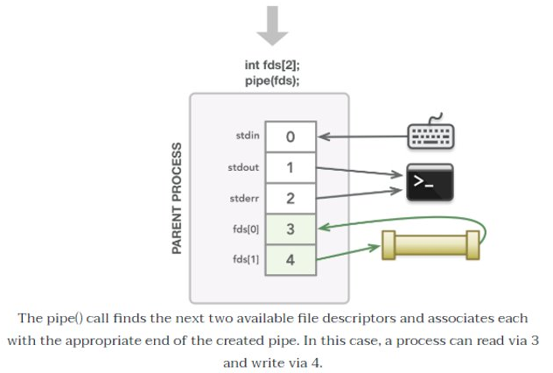
Descriptor Table After Pipe()

Slide 64
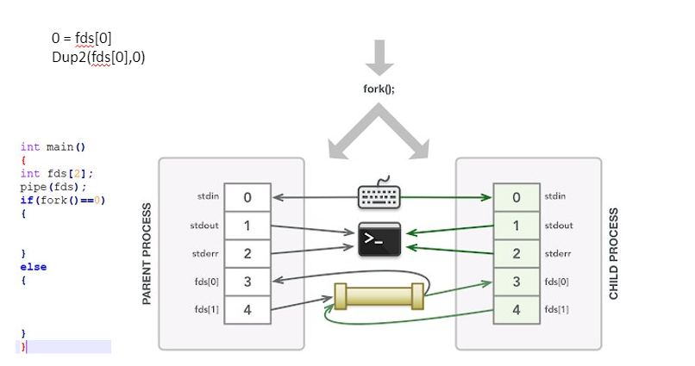
Descriptor Table After Fork()

Slide 65
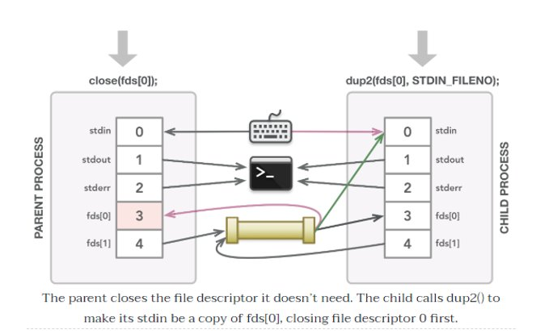
Making Stdin a copy of fds[0]

Slide 66
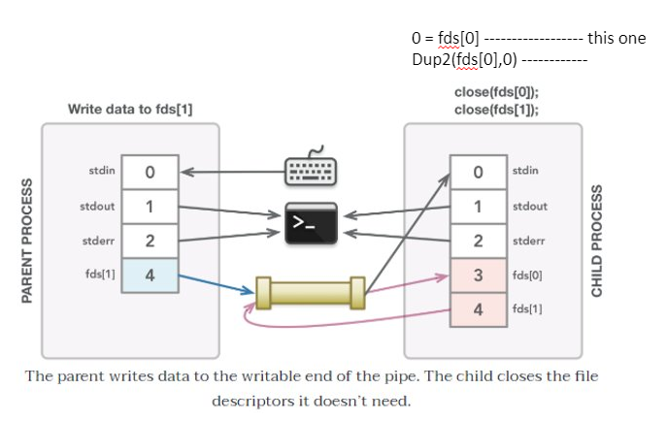

Slide 67
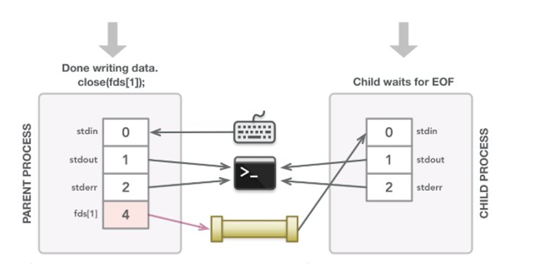

Slide 68
ls | sort
0
0
ls | sort
1
1
ls
sort

Slide 69
Lecture#11 code: ls / -R | grep ‘std’ | more

Slide 70
Lecture#12

Slide 71
Parent
Child
Child
Child
Fork()
Fork()
Fork()
Child
Child
Child
Child

Slide 72
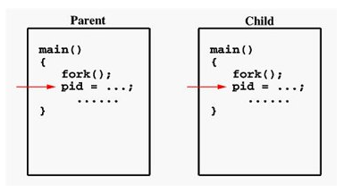
Why to create copy of a process?
After Fork(), a child process is created which is a copy of its parent process.​
The child process contains the same code as of parent process.​
Why to replicate process?​
So that different parts of a program come to execution. ​
Each process has 1 flow of execution. ​
Can we achieve the same without replicating address space?​

Slide 73
POSIX Threads​
Portable Operating System Interface for Unix (POSIX)​

Slide 74
Threads
It is flow of execution​
It is a basic unit of CPU utilization​

Slide 75
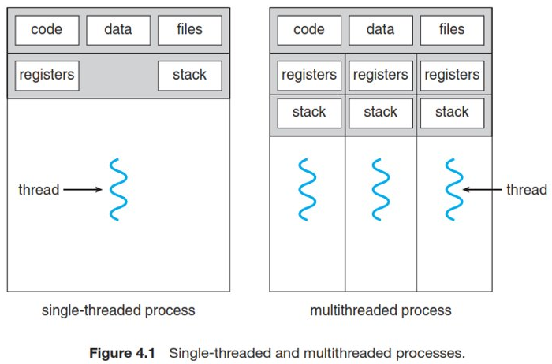
Threads

Slide 76
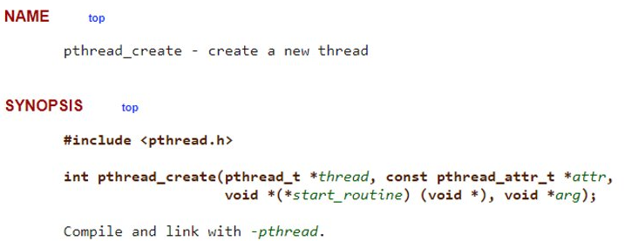
Creating POSIX Threads

Slide 77
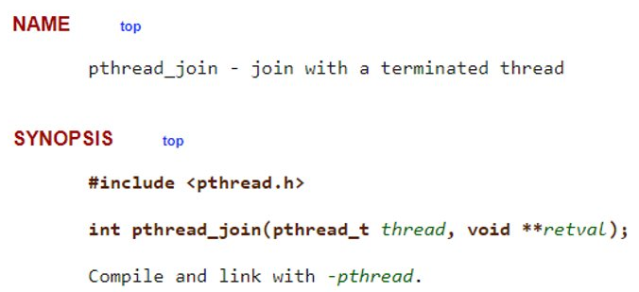
Joining threads

Slide 78
Example

Slide 79
Lecture#13

Slide 80
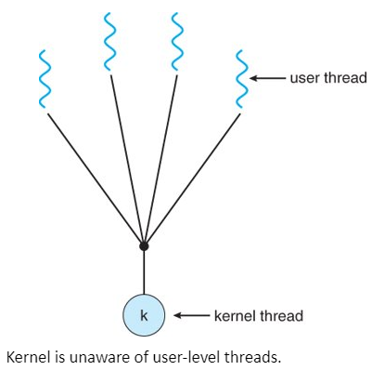
User Level Threads (Many to One Model)​
User-level threads are easy to create/cancel and manage.​
Can be created on OS have no native support for threads.​
Portable

Slide 81
Limitation of User-Level Threads
if one user thread performs IO whole process is blocked.​
User threads can’t exploit multiprocessing.​
User thread are not given separate time slice. They have to share the time slice given to one kernel-level thread they are mapped on.​

Slide 82
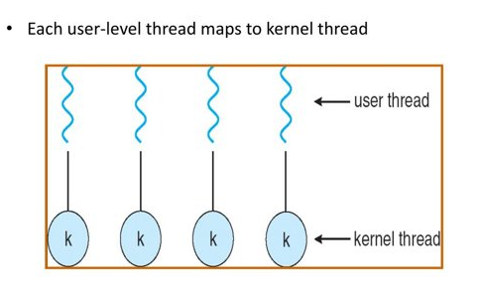
Kernel Level Threads (One to One Model)​
Each kernel thread can be scheduled on different CPU​
Each kernel thread is assigned separate CPU time (time slice)​
If one thread blocks, control is transferred to other thread. ​

Slide 83
Limitation of Kernel-Level Threads
Not portable​
Creation/Cancellation and synchronization involves kernel intervention through system call.​
Creation/Cancellation & Synchronization is slower than that of User-level threads.​

Slide 84
Code: Passing Arguments to Threads

Slide 85
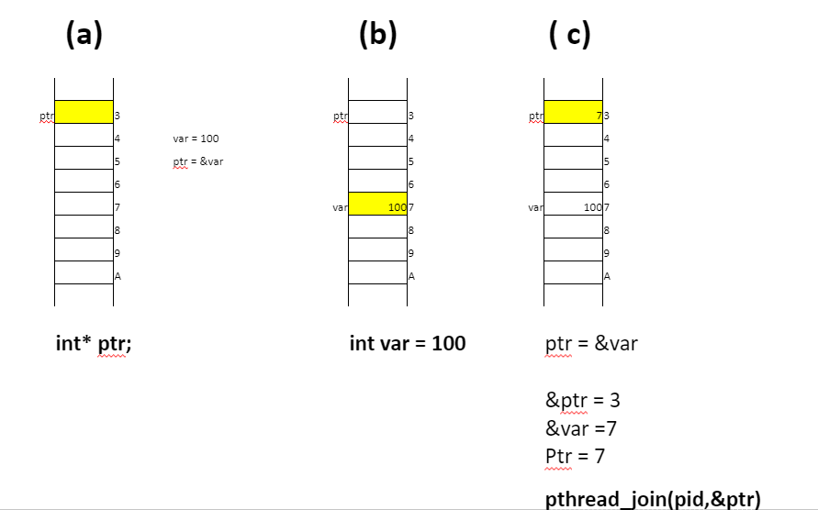

Slide 86
Code: Returning Value from Threads

Slide 87
Class Activity (11 September 2020) Lecture 16
Write a multithreaded program to sort an array of 1000 elements.
  All threads must be extended from the same function

Slide 88
Lecture-18

Slide 89
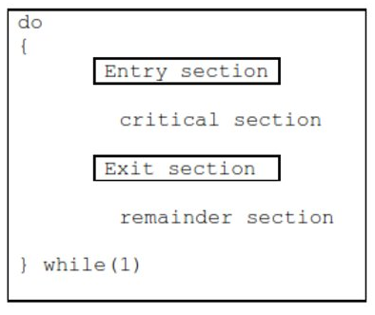
Solution to Critical Section Problem (Template)​

Slide 90
Valid Solution of Critical Section Problem​
Mutual Exclusion​
One thread at time should enter in its critical section. ​
Progress (Prevents Deadlock)​
In decision making, threads willing to enter their critical sections should participate​
Decision should be made in finite amount of time​
Bounded waiting (Prevents Starvation)​
There should be a bound on how many times a thread can re-enter its critical section while other has requested to enter its critical section.​

Slide 91
Algorithm-1
flag[2] = {0,0};​
Do //thread#1 { ​ flag[0]=true;​ while(flag[1]); ​ ​ critical section​ ​ flag[0]=false;​ ​ remainder section​ } while(1)​ ​ | Do //Thread#2 { ​ flag[1]=true;​ while(flag[0]); ​ ​ critical section​ ​ flag[1]=false;​ ​ remainder section​ } while(1)​ ​

Slide 92
Algorithm-2
turn = 0;​
while(turn != 0); //entry section​ ​ //critical section​ ​ ​ turn = 1; //exit section​ ​ //remainder section<-==========​ ​ | while(turn != 1);//entry section​ ​ ​ //critical section​ ​ ​ turn = 0;//exit section​ ​ //remainder section​ ​

Slide 93
Algorithm-3
flag[2] = {0,0}; turn = 0;​
Do //flag[0] turn=0 //thread#​ { ​ flag[0]=true;​ turn=1;​ while(flag[1] && turn==1){ }​ ​ critical section​ ​ flag[0]=false; ​ ​ remainder section​ } while(1) ​ | Do //flag[1] turn=1​ { ​ flag[1]=true;​ turn=0;​ while(flag[0] && turn==0);​ ​ critical section​ ​ flag[1]=false; ​ ​ remainder section​ } while(1) ​ ​

Slide 94
Hardware Solution
Context switching is done by timer interrupt. If we disable the timer interrupt then time slice won’t get expired, hence no synchronization issue. ​
How to disable interrupts​
CLI (Clear Interrupt Flag)​
How to do that in a High level language​
“asm(cli;)”​
Would it work?​
If no, Why?​

Slide 95
Hardware Solution
CPU provides some instructions in its ISA that can execute atomically. ​
Atomically means its execution can’t be interrupted once it is issued even on multi-core system.​
Such instructions once issued are committed.​

Slide 96
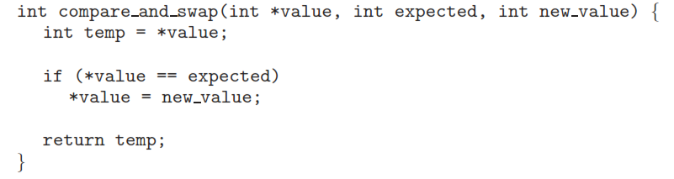
Atomic Instruction

Slide 97
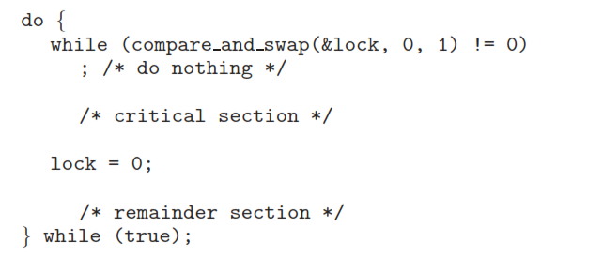
Use of Atomic Instruction

Slide 98
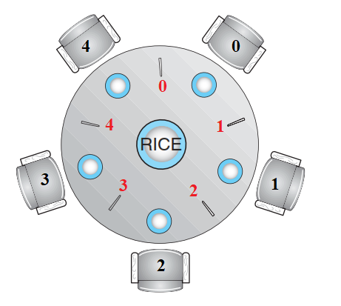
Dinning Philosopher

